Slide 1
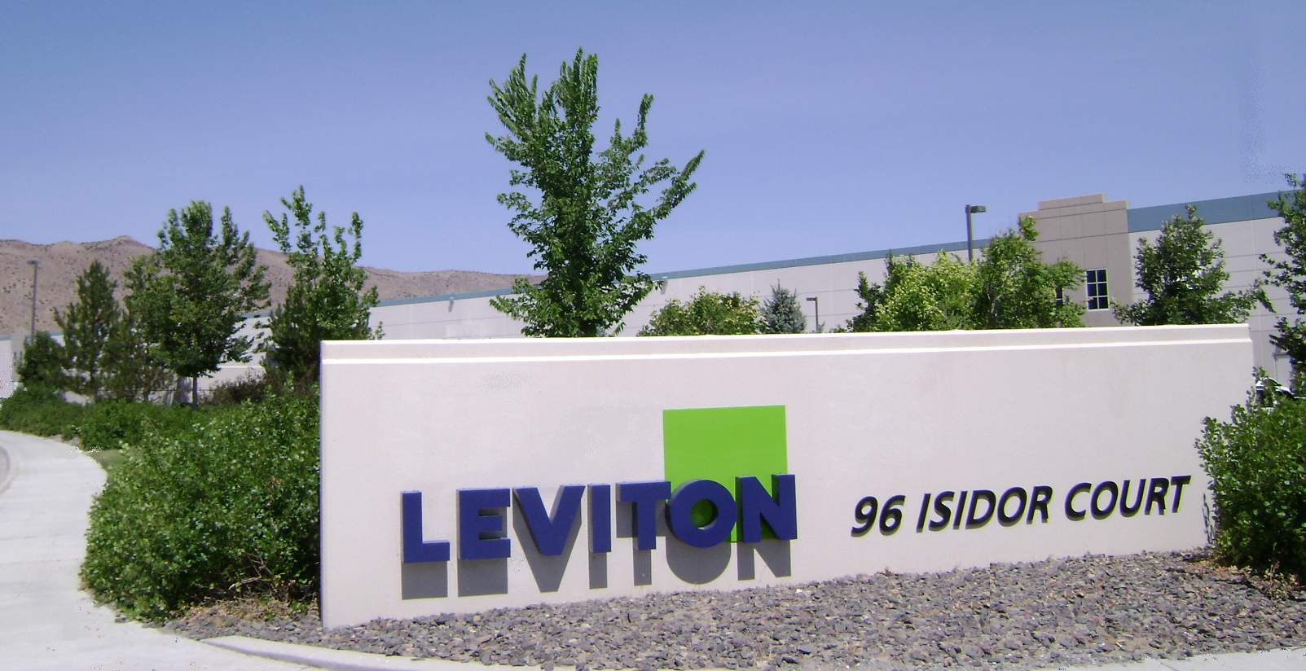

WESTERN DISTRIBUTION CENTER
SPANISH SPRINGS, NEVADA
Ken Miner
Notes:
Welcome to Leviton’s Western Distribution Center in Spanish Springs, Nevada.
Double digit yearly business increases in the years 1997 though 2000 plus the addition of the product from other divisions dictated a move to this new facility.
We are a semi-automated, “State of the Art” facility with 408,660 sq. ft. under roof, 31,000 pallet locations. We shipped our first carton in August 2000.
We employ 63 full time equivalents including 11 staff members, 1 person in corporate Quality Assurance, plus an additional person in corporate Materials Resource Planning.
We run two 8-hour shifts per day, five days a week. It takes approx. 16 people on each shift to do the picking, packing shipping and receiving. In addition to the people on the floor there are 13 support personnel in maintenance, inventory control, information technology and office clerical positions.

Slide 2


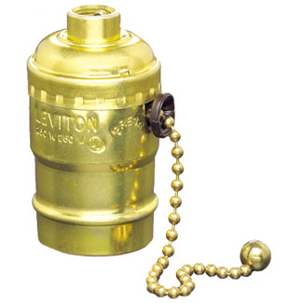


Leviton Manufacturing Company
Serving the Electrical Industry for Over 113 Years
Notes:
Let me tell you a little about Leviton.
Isidor Leviton founded the Leviton Manufacturing Co. at the dawn of the electrical era in 1906 in New York City. Isidor Leviton and his brother were originally engaged in the manufacturing of mantle tips for gas lighting, the Company soon converted production of a single electrical product – a pull chain lamp holder. Leviton has grown over the past 107 years to become the preeminent leader in our industry and the largest privately held manufacturer of electrical wiring equipment, data center connectivity, and lighting energy management systems in North America.
Leviton has remained a family owned business and was run by Harold Leviton for over 40 years. After his death, he was succeeded by Don Hendler in 2007

Slide 3
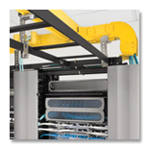

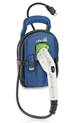



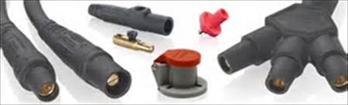
OVER 25,000 CATALOG ITEMS
Notes:
Today our product portfolio consists of over 25,000 devices and systems used in homes, businesses and industry, not taking into account the many colors and styles of the same item.
Leviton’s Networks Solutions manufactures an extensive offering of voice/data communication products for premise wiring. A state-of-the-art manufacturing complex in Bothell, Washington creates the next-generation products and manufacturing technologies that will bring the benefits of high-speed communications connectivity within reach of every potential commercial end-user, The Lighting Controls Division focuses on lighting controls and lighting control systems such as you would find in large churches, controlling lighting for a Las Vegas stage show or a Broadway musical. Fiber Connect is one of Leviton’s latest acquisitions supplying fiber optic devices. Leviton’s OEM Division offers a comprehensive line of incandescent, HID and fluorescent lamp-holders, plugs, receptacles, controls and automation products to a wide range of manufacturers who are able to cost-effectively integrate these products into their own products.
Leviton’s operations in China and Hong Kong complements product made in North America by efficiently extend the company’s global reach and adds new sources of capacity and manpower to best serve customers around the globe. The company’s overseas operations consist of: Leviton Pacific Rim, Ltd. at Hong Kong, Leviton Dongguan and Leviton Nanjing. Steadily expanding production and sales to meet the needs of the marketplace, Leviton’s overseas operations provide jobs for over 3,000 employees, many residing at the company’s on-site housing quarters.
Covering a large number of countries outside the United States, Canada and Mexico, the International Division delivers Leviton’s extensive product and service offerings to a global audience. Leviton has recently opened offices in Europe, South America, Australia-New Zealand the Middle East and South-East Asia, to supply its products, solutions and services to a growing base of international customers. Sales and distribution in India, Dubai, Puerto Rico, Denmark, Mexico and Canada.

Slide 4

100 % ACCURACY
IN A DISTRIBUTION WAREHOUSE?
P4
Notes:
4
Were going to talk today about how we achieve 100% accuracy in a distribution warehouse environment.
Actually I rounded up. Our error rate expressed as a ‘Defects Per Million Opportunities’ is .51year to date, or about one shipping error for every two million cartons shipped. Accuracy rate is 99.99995%

Slide 5
DISTRIBUTION CENTER SERVICE AREAS
WA
MT
ND
ME
OR
MN
VT
NH
ID
SD
WI
NY
MA
WY
MI
RI
IA
PA
CT
CA
NV
NE
OH
MD
NJ
Spanish Springs
UT
CO
IL
IN
DE
KS
MO
WV
VA
KY
TN
ND
AZ
NM
OK
AS
SC
MS
AL
GA
AK
TX
LA
FL
HI
Notes:
Leviton Spanish Springs is one of two Leviton Distribution Centers. The other is in Nashville, TN. Leviton Spanish Springs supplies product to Mexico, Canada, the seventeen Western United States, including Hawaii and Alaska. We also export to many Pacific Rim and European locations. To fill back-orders and outs we ship anywhere Leviton product is needed.
Spanish Springs ships approximately one third of the cartons, Nashville ships the balance.

Slide 6
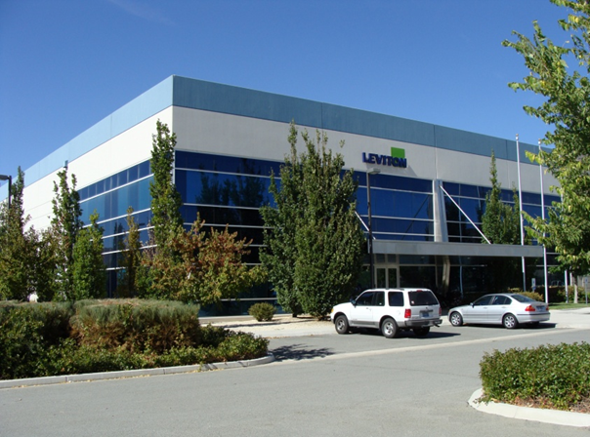
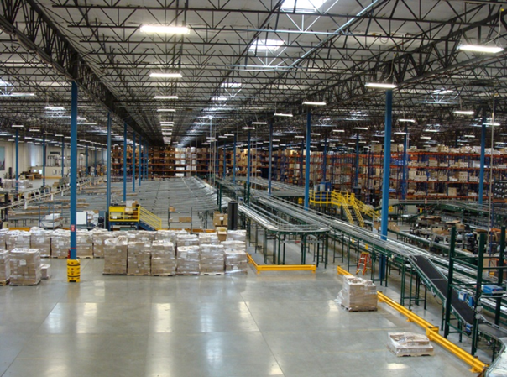
Spanish Springs, Distribution Center
  409,000 SQ Feet
  First Carton Shipped Aug 2000
  58 Full Time Employees
  2 Shifts 5 Days a Week
  ISO 9001:2015 Certified 2018
  19,500 Cartons per Day
  621 Orders per Day
  35% of U.S. Distribution Orders
  99.9% Ready to Ship in 24 Hrs. or Less

Slide 7

STATE OF THE ART SERVICE
SEMI-AUTOMATED
ISO 9001-2015 REGISTERED
99.9% 24 HOUR TURN-AROUND
85% CARTONS SHIPPED LTL
85% ORDERS SMALL PARCEL
Near 100% SHIPPING ACCURACY
Notes:
We are a semi-automated meaning that some of the work is done by people but much of the scanning is done by fixed laser scanners mounted on the conveyors.
We are ISO 9001-2008 registered by Underwriter's Laboratory. ISO 9001-2008 mandates a quality management system that focuses on satisfying customer requirements and continual improvement.
We ship an average of 15,000 cartons of product per day.
99% of the 400 daily orders are shipped within 24 hours.
85% of the cartons are palletized shipments carried by LTL truck lines. The other 20% are small parcel shipments that are delivered by UPS and FedEx Ground.
However, 85% of the orders are small parcel, 15% are LTL shipped by common carrier.

Slide 8
OUR CUSTOMERS
ELECTRICAL
DISTRIBUTORS
31% of CARTONS
RETAIL
STORES
51% of CARTONS
OEM
3 % of
CARTONS
EXPORTS & INTERNET*
15% of CARTONS
Notes:
=Spanish Springs customer base consists of:
Electrical Distributors, 50% of dollars shipped, 31% of the cartons; Examples: Graybar, CED, Platt, Rexel.
Retail Accounts, 28% of dollars, 51% of cartons: Home Depot, OSH, and Ace Hardware.
OEM users: 7% of the dollars and 3% of the cartons; Lithonia, Lights of America, but much of this product is shipped directly from the manufacturing plant.
Exports & Internet, which includes shipments to other Leviton facilities is 15% of the both dollars and total cartons shipped.

Slide 9

WHY WE DO….
WHAT WE DO
CUSTOMER DRIVEN
EMPHASIS ON ACCURACY
REDUCES TRANSACTION COSTS
Notes:
As a result of several meetings with our customers, we designed a system to give our customers what they want. At the top of their list was fill rate, followed by accuracy and on time delivery.

Slide 10
BAR CODE INSURES ACCURACY
PRODUCT IDENTIFICATION
CARTON LOCATION
SHIPPING INSTRUCTIONS
SOURCE/COUNTRY OF ORIGIN
ALL ACCESSED BY SCANNING THE BAR CODES
Notes:
Product information, location of product and shipping instructions are all accessed through the scanning of Bar Codes on product, cartons, shipping labels, packing lists and storage racks.
Our scanner at the labeling applicator can even scan to determine the country of origin so that we avoid shipping product that will be charged duty when it’s destination is a NAFTA country.
We scan the cartons at receiving, put away, picking, when a label is applied and at the pallet building areas....

Slide 11
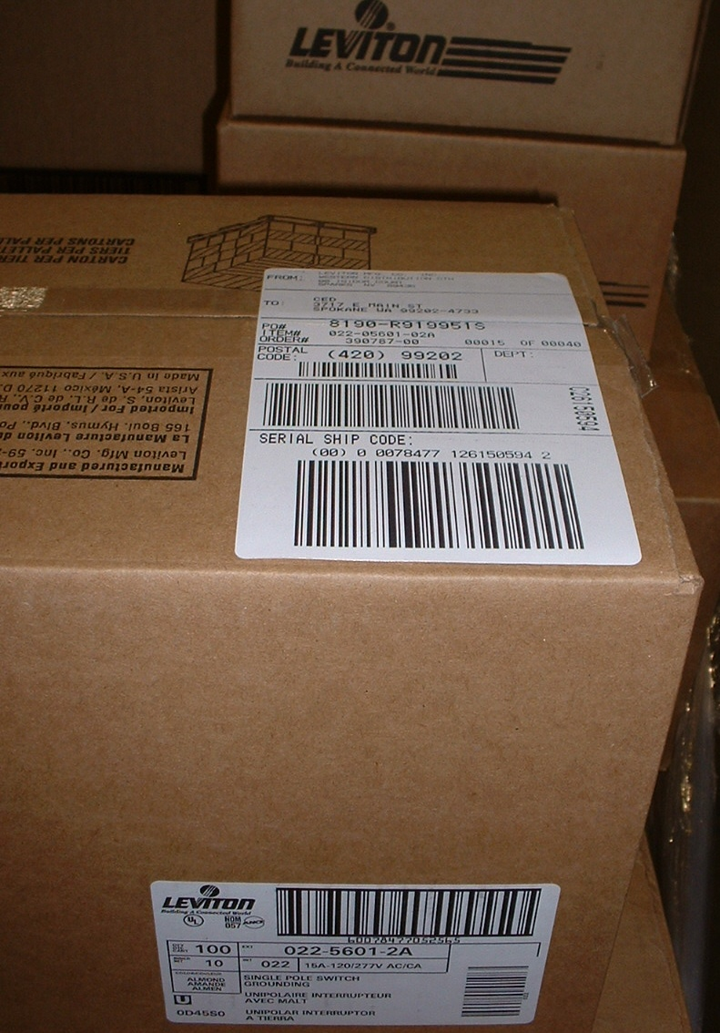
REDUNDANT SCANNING
PRODUCT AND SHIPPING LABEL….
BOTH MULTI-SCANNED
Notes:
Note the multiple bar codes on the shipping label and the product label. All are used to either verify accuracy at our shipping facility or the customers place of business.
Large customers scans the ASN/UCC128 bar-code at the bottom of the label in their receiving process.
Home Depot also uses scans a portion of the label to sort orders at their transit centers to determine the ultimate store destination.
All information is accessed and stored through an IBM AS-400 computer, connected to the main frame computer in Melville, New York.
The system operates in ‘real time’ and the on-hand quantities and locations of inventory within the Distribution Center are updated immediately.
We are able to track the movement of a given carton, whether it is in a receiving lane waiting to be put away, on the conveyor, on the shipping dock or even while it is sitting on a fork lift being transported between these points.

Slide 12
INSTANT INFORMATION
CORPORATE
MAIN FRAME
IBM AS400
ON-HAND
QUANTITIES
IN THE RACKS
IN RECEIVING
INVENTORY
MOVEMENT
ON THE CONVEYOR
ON THE SORTATION LOOP
SHIPPING
INFORMATION
ON THE DOCK
ON THE TRUCK
PRODUCT
INFORMATION
MINIMUMS /MAXIMUMS
ITEM DETAILS
ALL ACCESSED AND UPDATED
IN REAL-TIME
Notes:
All information is accessed and stored through an IBM AS400 computer, connected to the main frame computer in Melville, New York.
The system operates in ‘real time’ and the on-hand quantities and locations of inventory within the Distribution Center are updated immediately.
We are able to track the movement of a given carton, whether it is in a receiving lane waiting to be put away, on the conveyor, on the shipping dock or even while it is sitting on a fork lift being transported between these points.

Slide 13
MIXED CARTON ERROR ELIMINATION!
100% ELECTRONIC VERIFICATION
Notes:
100% follow-up electronic verification on less than full carton orders provides error free open stock shipments.
Multiple verifications utilizing bar codes eliminates errors before they get out of the building.
This redundant bar code scanning eliminates the order discrepancies and the ‘soft costs’ associated with them, not only for Leviton, but also our customer partners.

Slide 14
USE OF TECHNOLOGY &
BEST PRACTICES
HANDHELD/EQUIPMENT MOUNT
RF TERMINALS
SYSTEM DIRECTED PUTAWAY
PRODUCTIVITY STANDARDS AND TRACKING
ADVANCED SHIPPING NOTICE
EDI & VMI
GOLDEN ZONING
CONTINUOUS IMPROVEMENT TEAMS
Notes:
In addition to bar codes, Leviton Spanish Springs utilizes:
Handheld and Equipment mounted RF Scanners
System Directed Putaway
Productivity Standards and Productivity Tracking
Cross training between departments
Advanced Shipping Notice
Electronic Data Interchange with both customers and carriers
Vendor Managed Inventory
Golden Zoning
Continuous Improvement Teams

Slide 15
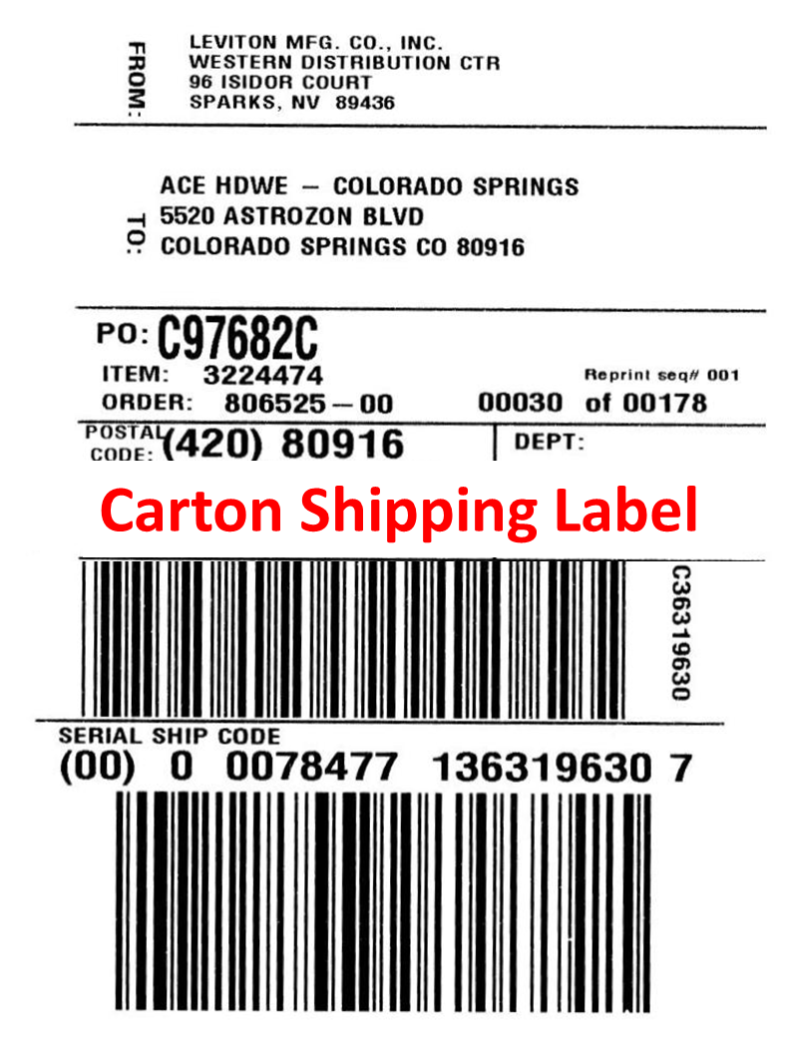
CUSTOMER FRIENDLY ORDERS
SORTED ON PALLET
COMPLETE ORDER INFORMATION ON THE SHIPPING LABEL
COMPLETE ACCOUNT AND BILLING INFORMATION ON PACKING LIST
NUMBERED CARTONS REFLECTED ON PACKING LIST
Notes:
All shipping labels contain the following information:
· Shipping address
· Return address
· Carton number sequence with total number of cartons
· PO number (if supplied by the customer).
· Item catalog number or customer’s product identification number
· Order number, which becomes the invoice number
. Advanced Shipping Notice UCC-128 bar coding
· Bar Code identifier for automatic sortation & internal use
. The packing list is located on one carton with every order. An easy to identify fluorescent label indicates carton with packing slip.
. All UPC numbers, product identification information, carton numbering and quantities shipped in full or mixed cartons is clearly indicated on the packing list.
. Each carton is numbered and corresponds to the numbering on the packing list.

Slide 16
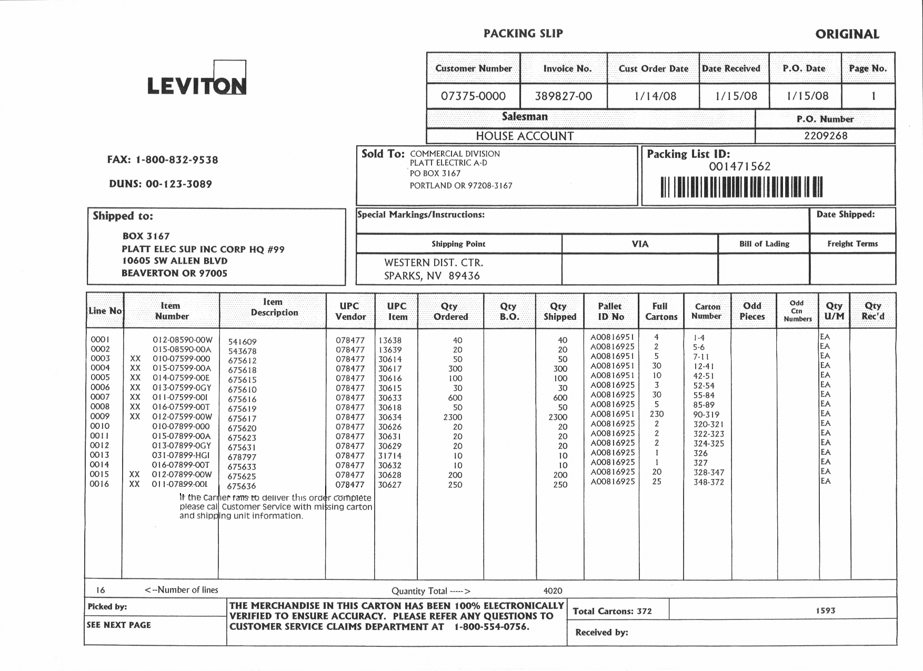
Leviton Wholesale Customer
Anywhere, USA
Leviton Customer
Anywhere, USA
TOTAL CARTONS: TOTAL WEIGHT:
393 1,573 #
LINE SAN CATALOG ITEM UPC UPC QUAN QUAN QUAN FULL CARTON
NO *** NUMBER DESCR VENDOR ITEM ORDERED BACK ORD SHIP CTN NUMBER
0016 011 07899-00I 675636 078477 30627 250 250 25 348-372
Notes:
Example of a Packing List with all pertinent data to make the customer’s receiving process easier.

Slide 17
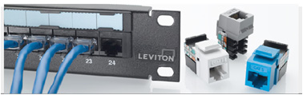
SECURE & COMPLETE
ERROR-FREE SHIPPING
ALL PALLET ORDERS WRAPPED TOP AND SIDES
PALLET CONTAINS LIST ON EACH PALLET
PACKING LIST LOCATION CLEARLY MARKED
MATCHING BILL OF LADING
Notes:
All orders are completely wrapped top and sides. Small parcel orders, are bundled with heavy duty heat shrink plastic.
A Pallet Contains List is located on the wrapping of every pallet, providing details for the product on that pallet only.
A matching Bill of Lading indicating the order number, PO number, total shipment weight and total number of cartons

Slide 18
TAKING THE EXTRA STEP
TOLL FREE 800 NUMBER
CONTENTS LISTED ON THE OUTSIDE OF MIXED CARTONS
CARTON CONTAINS LIST ON THE INSIDE
“SOFT COST” SAVINGS FOR LEVITON AND OUR CUSTOMERS
Notes:
We take order and item identification one step further for ease of receiving by our customer.
Also contained on the packing list is the complete account and billing information as well as the 800 toll free number for Customer Service in the event of a question about the shipment.
In addition to the packing list, the orders are further identified by:
. A Carton Contains Label on the outside of every carton of mixed product.
. A corresponding Carton Contains List on the inside will assist in the verification and location of items by the customer.

Slide 19
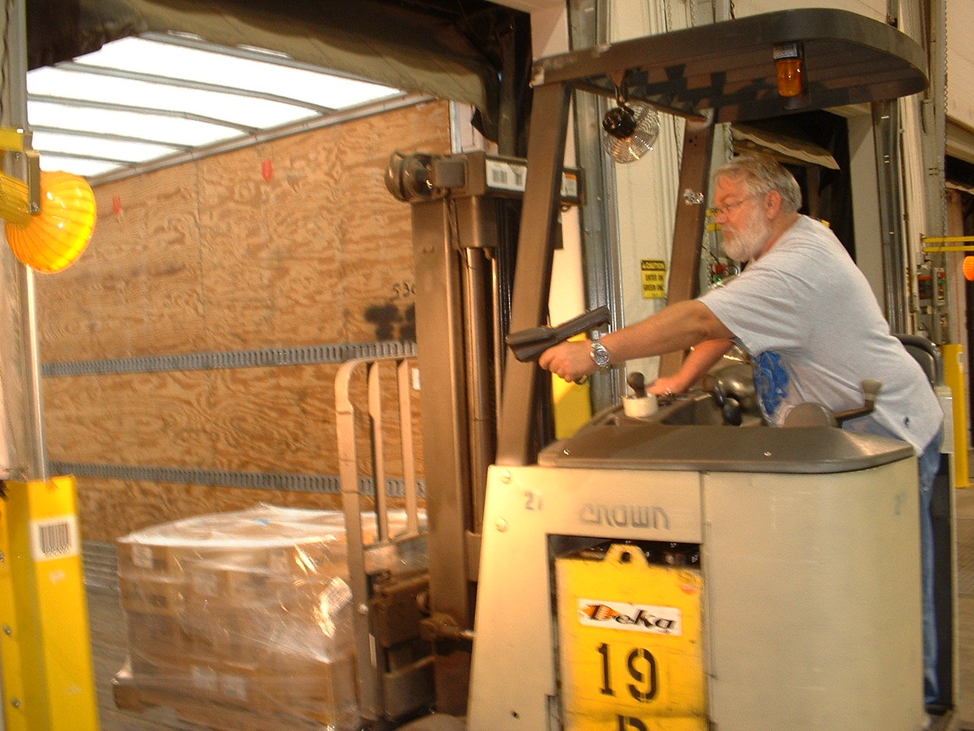
ELECTRONICALLY SCANNED ONTO THE CARRIER’S TRUCK
Notes:
As a final verification step, all orders are scanned from the dock onto the carrier’s truck.
These steps insure that the order arrives at the customer’s dock complete, on time and undamaged.

Slide 20

SPANISH SPRINGS DISTRIBUTION CENTER
READY TO SERVE !
Notes:
Leviton Spanish Springs stands ready to serve our customers with accuracy, high fill rates and on time shipping.
In today’s highly competitive business atmosphere we must ask our customer everyday….“What else can we do for you?”

